Slide 1
NGBoost: Natural Gradient Boosting for Probabilistic Prediction
Authors: Tony Duan, Anand Avati, Daisy Ding, Khanh K. Thai,
Sanjay Basu, Andrew Ng, Alejandro Schuler
Presented By: Chella Thiyagarajan N (ME17B179)

Slide 2
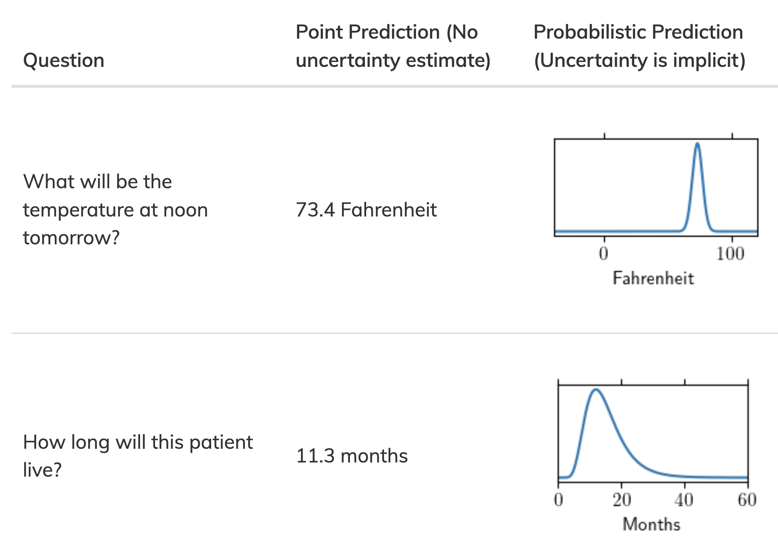
Probabilistic Prediction
X=x
E[Y|X=x]
P(Y|X=x)

Slide 3
Probabilistic prediction is already standard for classification
Regression
Classification
Will this patient get sepsis during this hospitalization?
P(no) = 0.87
P(yes) = 0.13
no

Slide 4
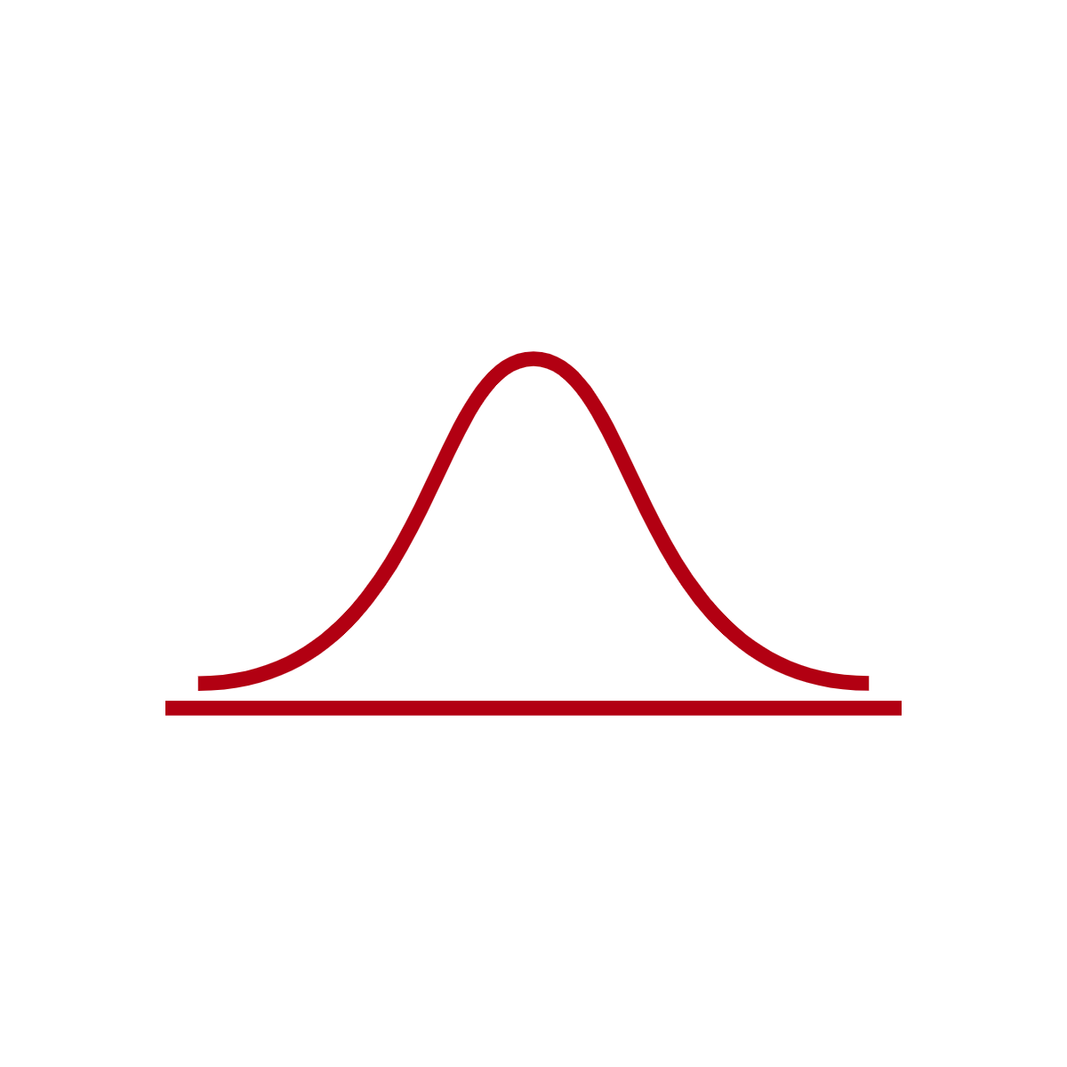
Assume P(Y|X=x) has some parametric form
μ = 1
σ = 1
μ = 2
σ = 0.5
μ = 2.5
σ = 0.75
μ = 3.5
σ = 1.5

Slide 5
Existing probabilistic methods for regression are slow, inflexible, don’t scale, and hard to use
Post-hoc variance
Assumes homoscedasticity
GAMLSS
Linear mean model
Bayesian methods
MCMC needed for complex models
Bayesian deep learning
Requires expertise

Slide 6
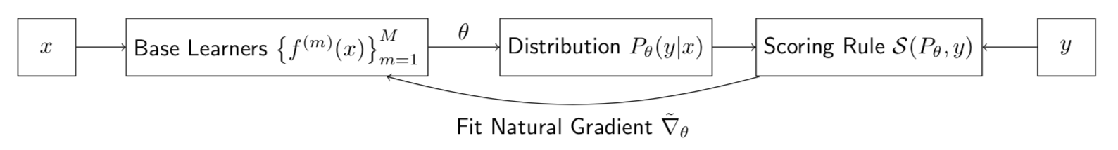
Outline of our approach

Slide 7
Pick a scoring rule to compare probabilistic predictions to ground truth
Point Prediction | Loss Function
Probabilistic Prediction | Scoring Rule
Example scoring rule: negative log-likelihood

Slide 8
Assume P(Y|X=x) has some parametric form
μ = 1
σ = 1
μ = 2
σ = 0.5
μ = 2.5
σ = 0.75
μ = 3.5
σ = 1.5

Slide 9
Use gradient boosting to estimate the parameters as a function of x
Review gradient descent for parametric models
Understand how boosting is gradient descent in functional space with an approximated gradient
Understand how gradient boosting can be used to fit probabilistic regression models

Slide 10
Gradient descent for a parametric model: the loss surface

Slide 11
Gradient descent for a parametric model: the gradient
In other words, the derivative we know how to compute from calculus happens to tell us which way to adjust the parameters
-

Slide 12
More generally,

Slide 13
Gradient descent for a parametric model

Slide 14
Assuming a parametric form is restrictive
Boosting idea: the prediction itself is the parameter

Slide 15
The gradient is even easier to derive now. For example, with squared-error loss,

Slide 16
The gradient is even easier to derive now. For example, with squared-error loss,

Slide 17
If we start with a model θ₀(x) = 0 for all x and take B steps, the final model is

Slide 18
What happens when we try and predict at a new value of x?
We never saw y here, so we can’t compute what the gradient would be at any iteration!

Slide 19
Gaps in the gradient

Slide 20
Gaps in the gradient

Slide 21
Gaps in the gradient

Slide 22
Gaps in the gradient

Slide 23
Gaps in the gradient

Slide 24
Boosting idea: fill in the gaps with a regression model (base learner)

Slide 25
Boosting idea: fill in the gaps with a regression model (base learner)
Must do this at each step

Slide 26
Taking B steps starting at 0, our model is
To predict at a new x, sum up the predictions of each of the B regressors at that x

Slide 27
NGBoost idea: we can apply this strategy to fit probabilistic regression models

Slide 28
Example: NLL score and Normal distribution

Slide 29
So instead of boosting one function, we need to boost as many as there are parameters
At each boosting iteration, we fit p models, one per parameter

Slide 30
At the end of this, we have, for any x, a predicted distribution of y

Slide 31
Outline of our approach
Pick a scoring rule to grade our estimate of P(Y|X=x)
Assume that P(Y|X=x) has some parametric form
Fit the parameters θ(x) as a function of x using gradient boosting
Use the natural gradient to correct the training dynamics of this approach

Slide 32
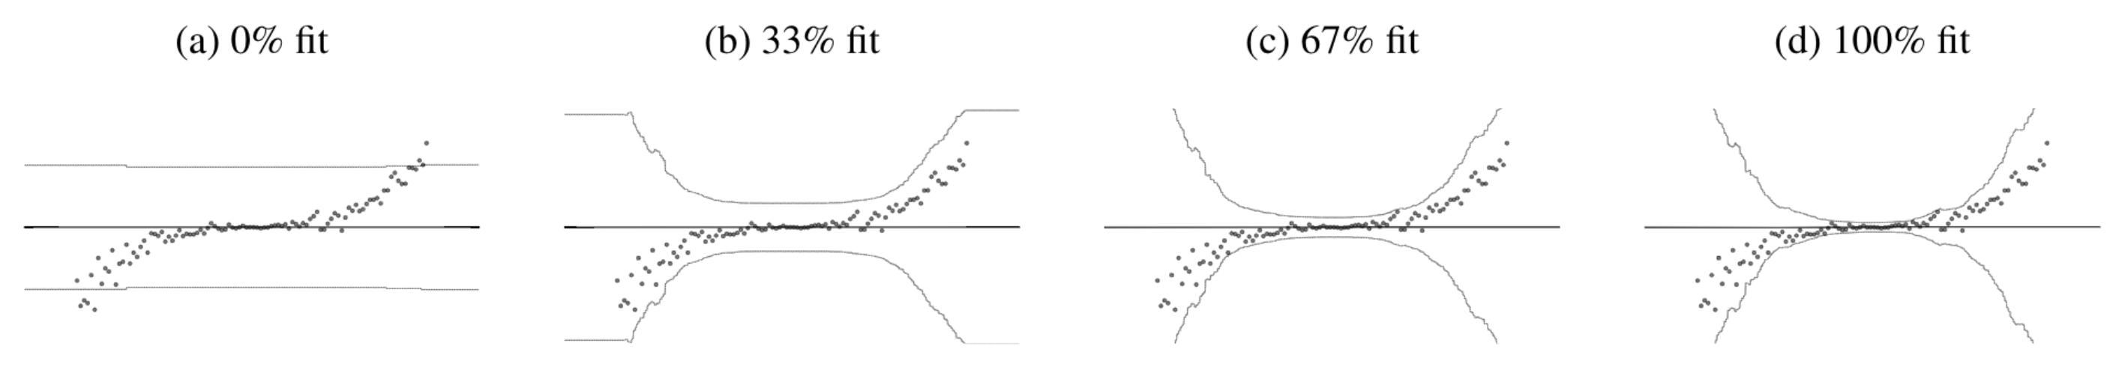
Our boosting approach gives us probabilistic prediction, but performs poorly

Slide 33
Ideal probabilistic regression

Slide 34
Why?
We relaxed an unrealistic assumption, so we expect performance to increase, not decrease
However, this picture suggests that the algorithm is failing to adjust the mean (in this example).
There is a better optimum, but we can’t find it

Slide 35
Outline of our approach
Pick a scoring rule to grade our estimate of P(Y|X=x)
Assume that P(Y|X=x) has some parametric form
Fit the parameters θ(x) as a function of x using gradient boosting
Use the natural gradient to correct the training dynamics of this approach

Slide 36
Stepping back: the space of distributions P(Y|X)
Distributions of the desired parametric form
P

Slide 37
What we typically do: gradient descent in the parameter space

Slide 38
Gradient descent in the parameter space is not gradient descent in the distribution space because distances don’t correspond

Slide 39
Idea: do gradient descent in the distribution by searching parameters in the transformed region
this is the natural gradient

Slide 40
We can conveniently compute the natural gradient by applying a transformation to the gradient
is the Riemannian metric of the space of distributions
It depends on the parametric form chosen and the score function
If the score is NLL, this is the Fisher Information

Slide 41
Why? To solve this optimization (for NLL)…
Use KL divergence as the distance in distribution space
Not arbitrary- every scoring rule induces its own divergence
Take the 2nd order Taylor expansion to see that KL divergence between distributions with parameters and is approximated by
Write the optimization in Lagrangian form, set derivative to zero, gives:

Slide 42
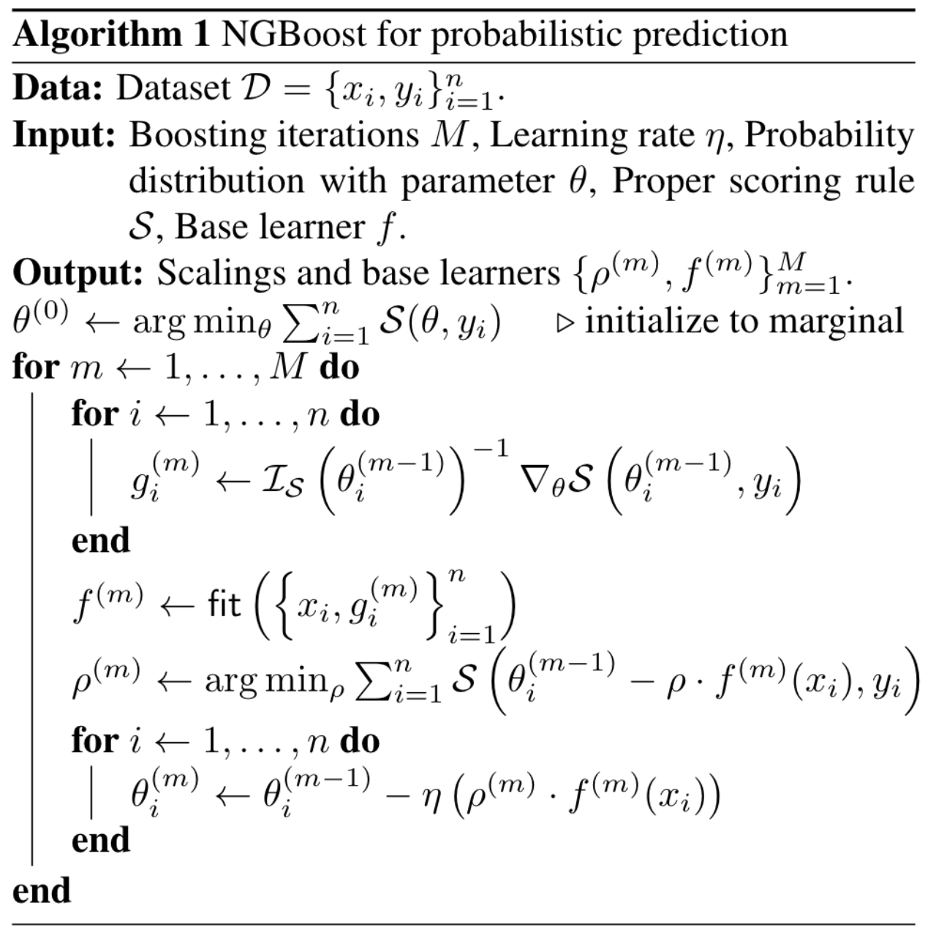
NGBoost is our multiparameter boosting approach with a natural gradient update

Slide 43
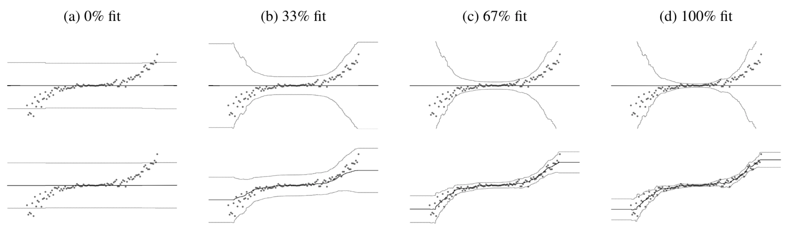
… by improving the training dynamics
Ordinary
Natural

Slide 44
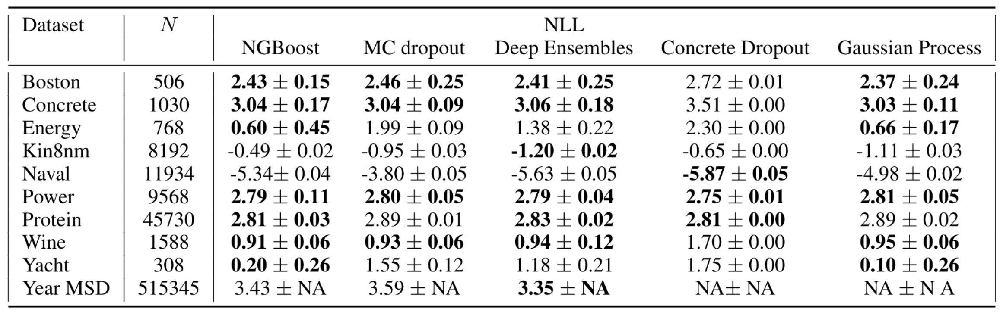
The result is equal or better performance than state-of-the art probabilistic prediction methods
(same experimental setup as previously described)

Slide 45
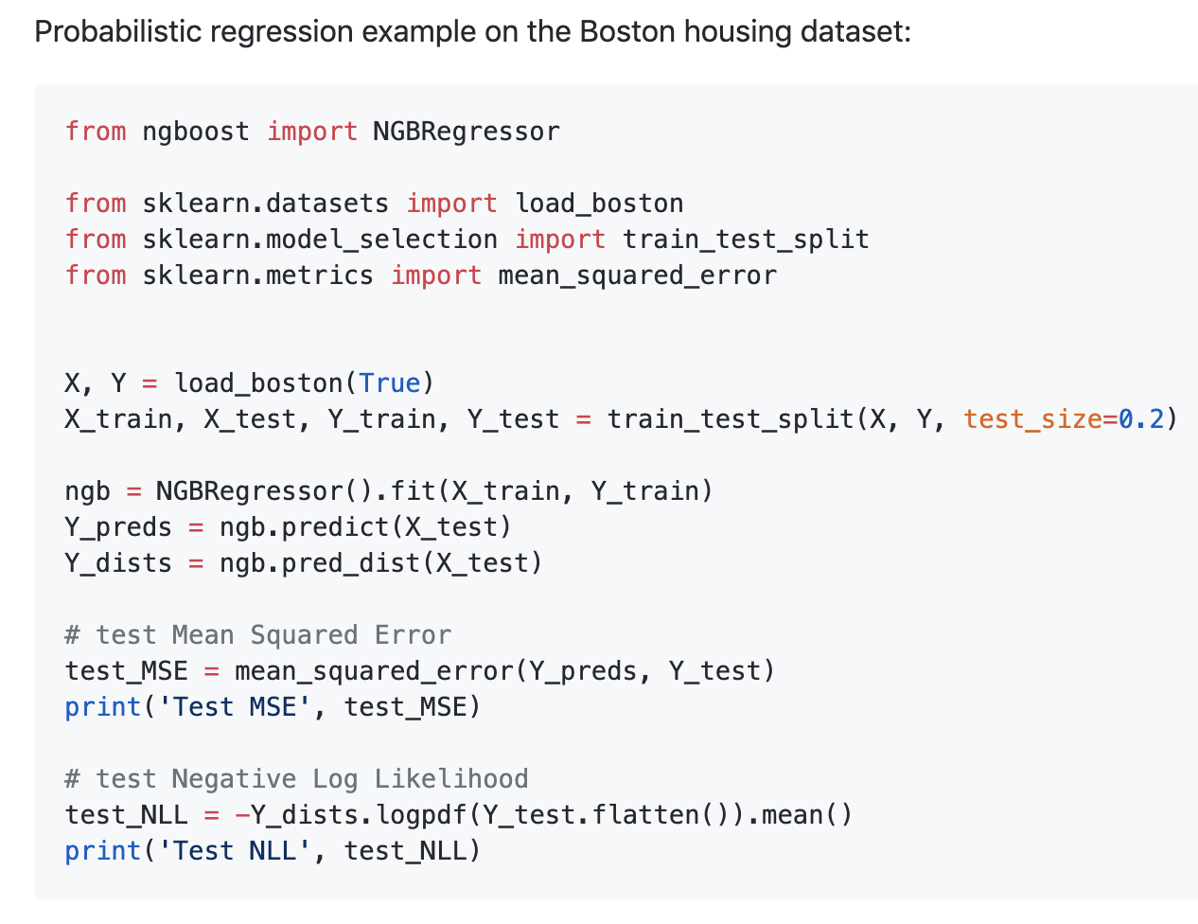
But unlike other methods, NGBoost is fast, flexible, scalable, and easy to use
No MCMC
Few restrictive assumptions
Works for regression, classification, survival, etc.
Scales like gradient boosting
Scikit-learn compatible

